Slide 1
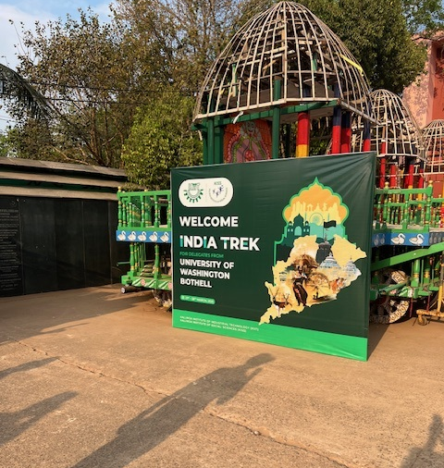

KIIT India Trek
University of Washington Bothell Faculty and Students and
University of Washington, Faculty
March 19-28

Slide 2
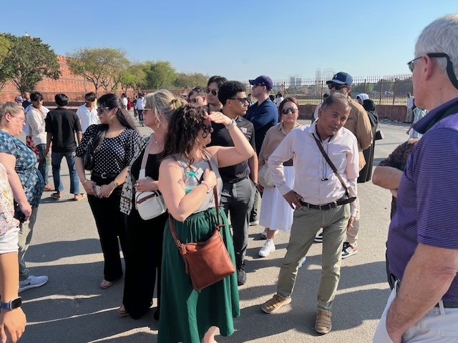
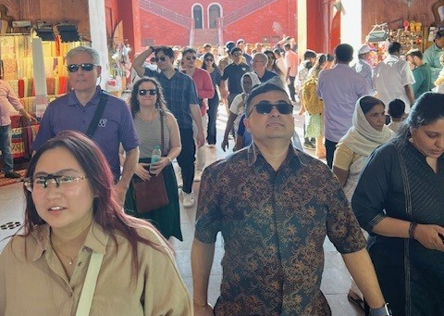
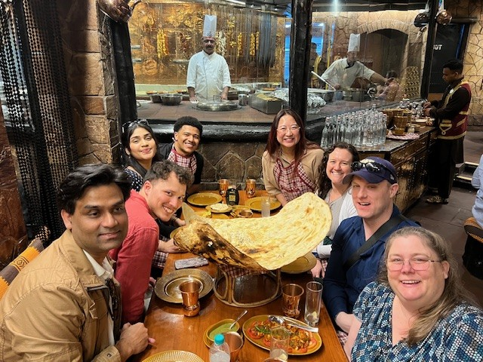
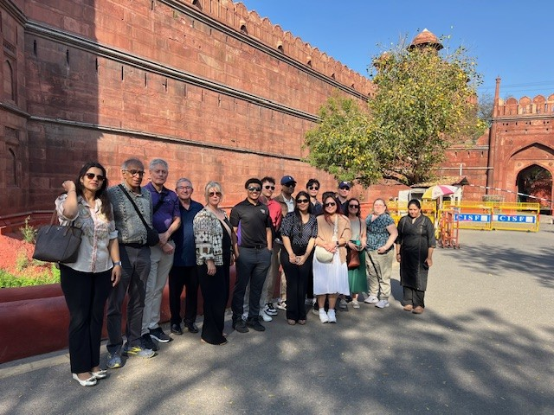
Day 1-- Delhi
Visit to Bukhara for lunch with our host Vikramaditya Dwiti and his team an heir famous naan and Dal Makhani. Followed by a visit to The Red Fort in New Delhi

Slide 3
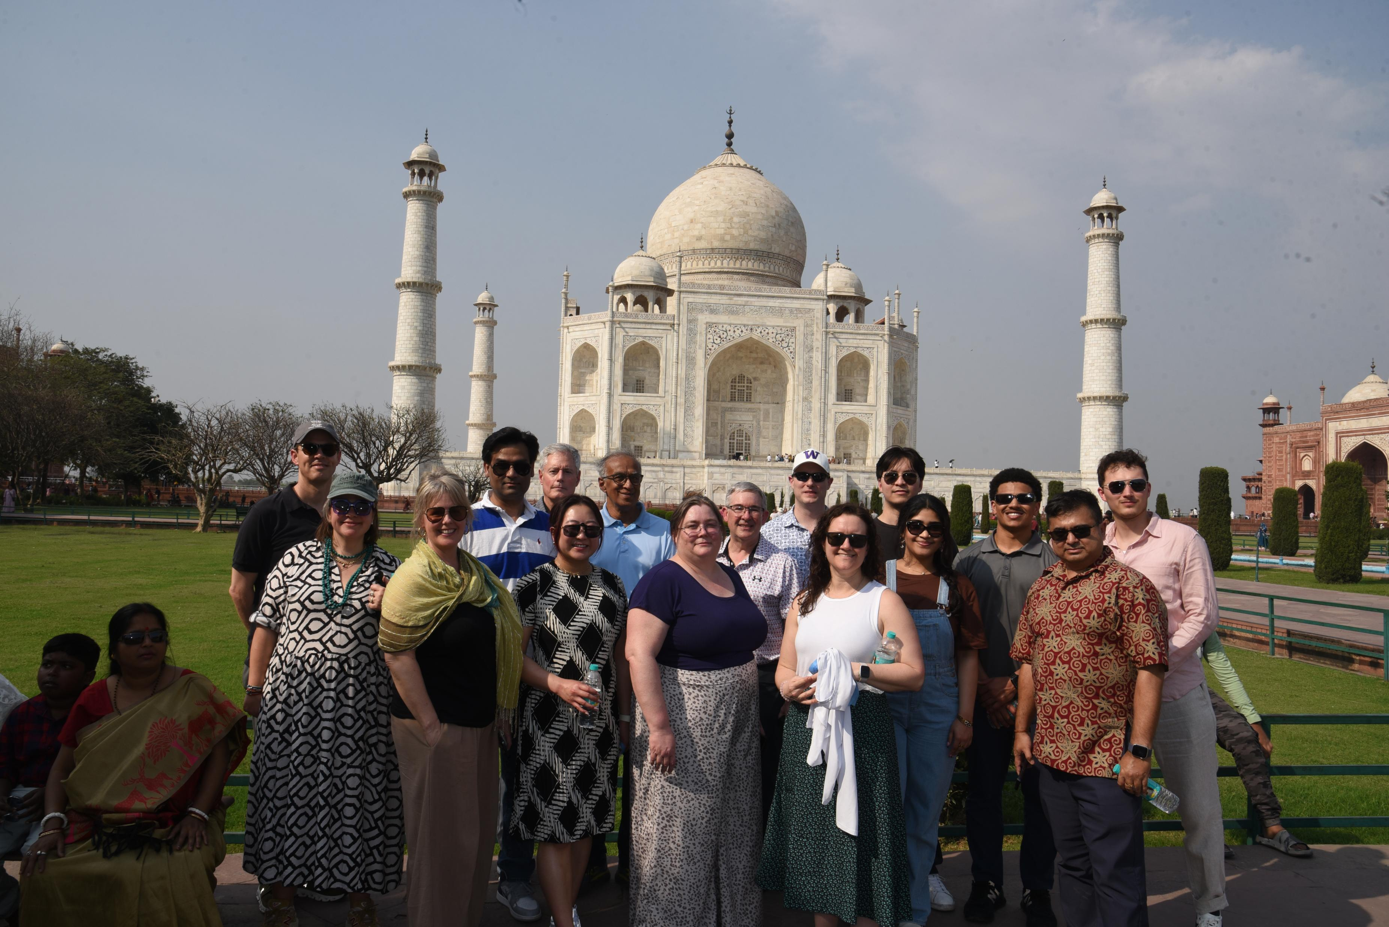
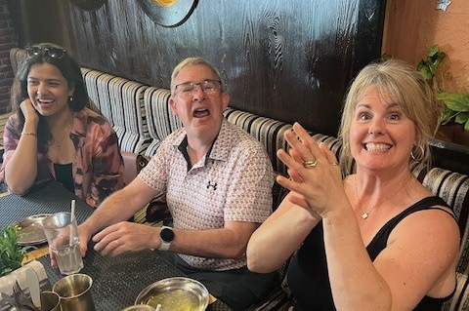
Day 2 – Agra Fort
Day 2 Visit to Taj and of course eating our though Agra

Slide 4
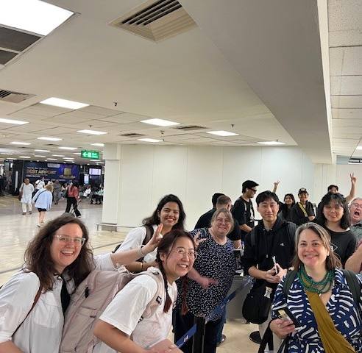
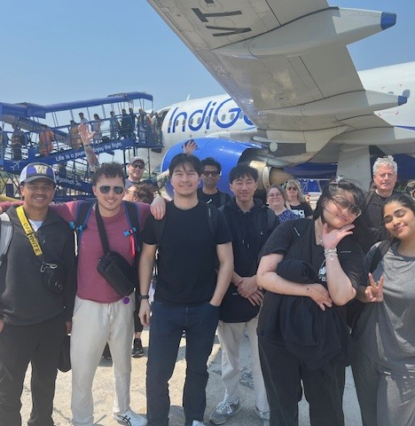
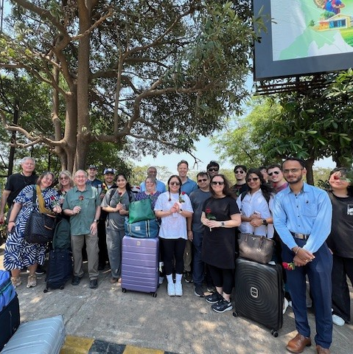
Day 3 – Bhubaneswar and KIIT, KISS
Arrival in Bhubaneswar excited to start our main portion of the study tour and visit to KIIT and KIIS

Slide 5
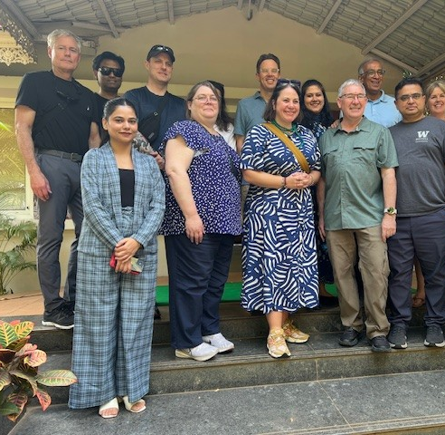
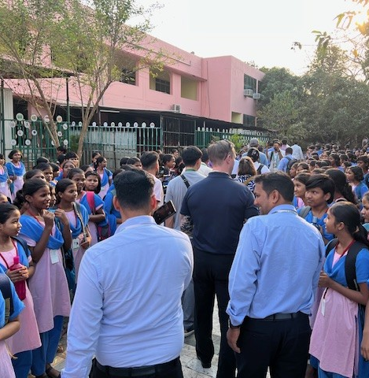
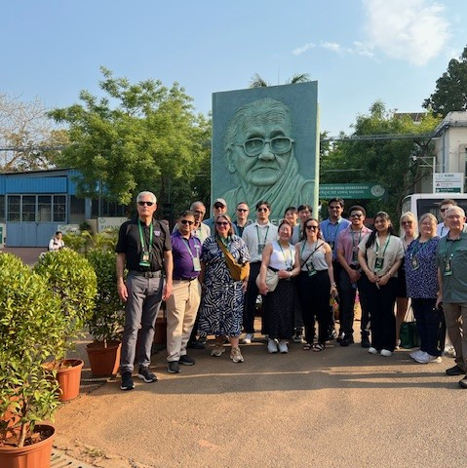
Day 3 – KIIT and KIIS
Tour through both campuses to get an initial insight to what we are going to experience.

Slide 6
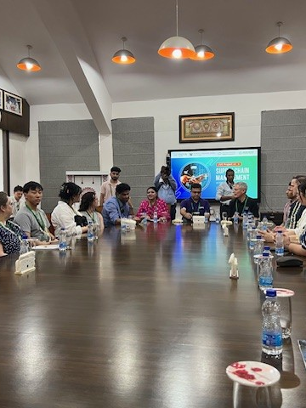
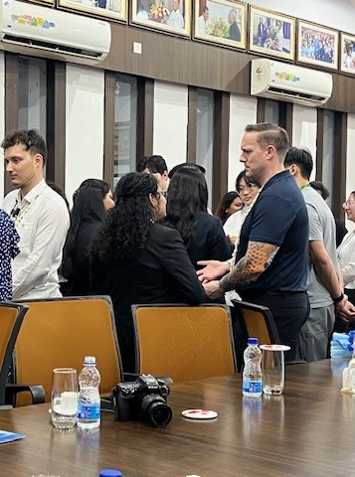
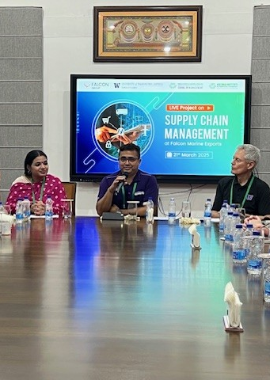
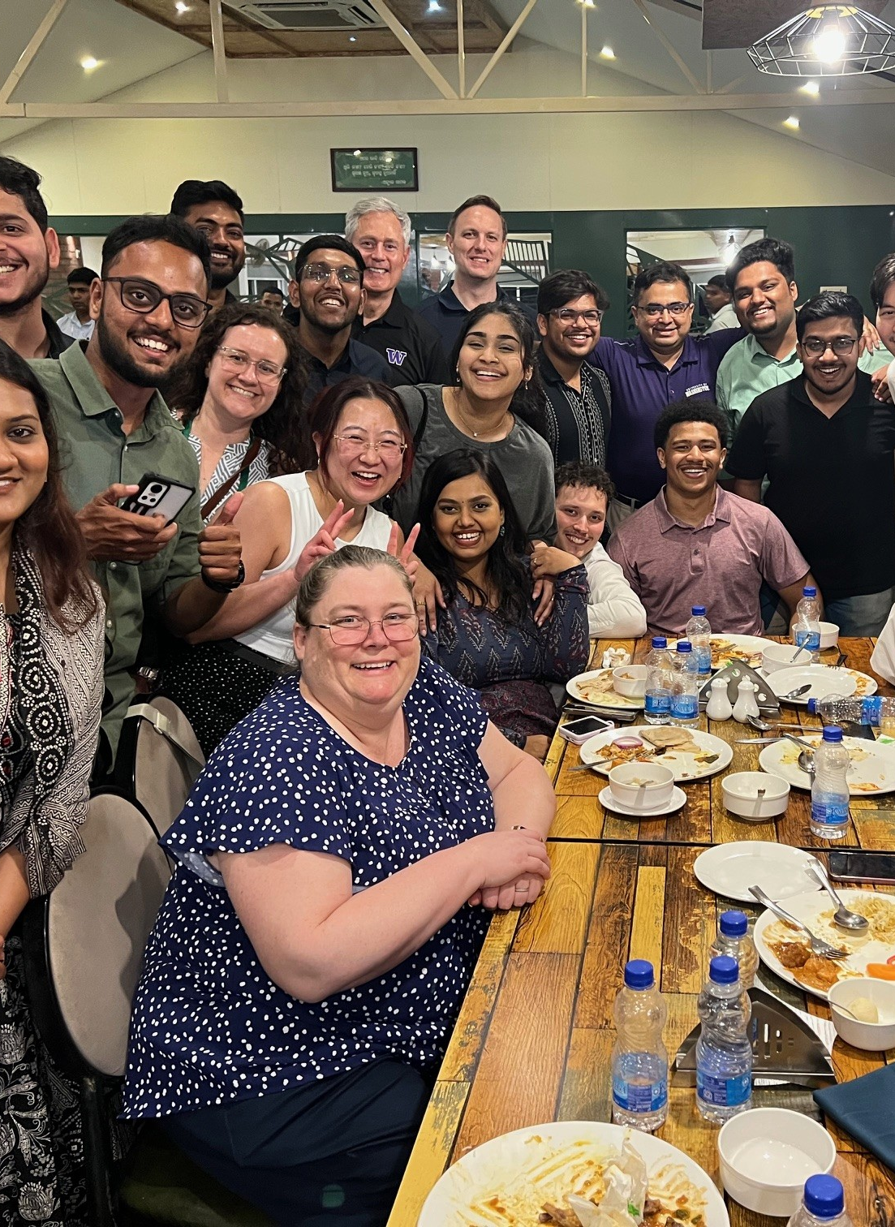
Day 3 – KIIT School of Management
Inauguration of the joint project that students from KIIT School of Management and UW Bothell students will be working on with Falcon Industries.

